Slide 1
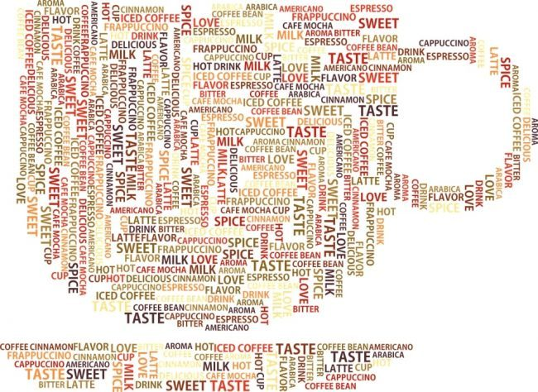


Slide 2
What is an Anagram?
A word, group of words or phrases formed from rearranging or choosing from the letters of another word or choosing. Let’s take a look at the sample below:
ANAGRAM
AN | AM | MA | RAN
RAM | MAN | NAG | GRAM
NAG A RAM

Slide 3
FLOWER

Slide 4
BELOW

Slide 5
PRESIDENT

Slide 6
PEOPLE

Slide 7
EXPLORE

Slide 8
SUPPER

Slide 9
PEDESTRIAN

Slide 10
Unlimited

Slide 11
PRECISE

Slide 12
FRIENDS

Slide 13
Flower | Fowler, Reflow, Lower, Rowel, Fowl, Role, Wore, Flew, Wolf, Fore, Owl, Woe, etc.
Below | Low, Woe, Owe, Bow, Elbow, Bowel, Blow, Blew, Bowl, Web, Owl, etc.
President | Resident, Red, Sit, Reside, Dent, Site, Preside, Repent, Entries, Serpent, Stipends, Striped, Desire, Desert, Pretend etc.
People | Pole, Pop, Peep, Pope, Peel, Elope, etc.
Explore | Repel, Expel, Elope, Leper, Expo, Lope, Pole, Rope, Role, Pore, Peer, etc.
Supper | Sure, Pure, Upper, Purse, Super, User, Prep, etc.
Pedestrian | Red, Train, Rain, Drain, Steer, Trainee, Rest, Printed, Preside, Depart, Ripened, Present, Striped, Sardine, Earned, Trends, Snared, etc.
Unlimited | Limit, Unite, Den, Lie, Minute, United, Limited, Mint, Dilute, etc.
Precise | Rice, Rise, Recipe, Sip, Prices, Specie, Crisp, Creep, etc.
Friends | End, Fried, Den, Fries, Sin, Fired, Rinse, Siren, Find, Finder, etc.

